Slide 1
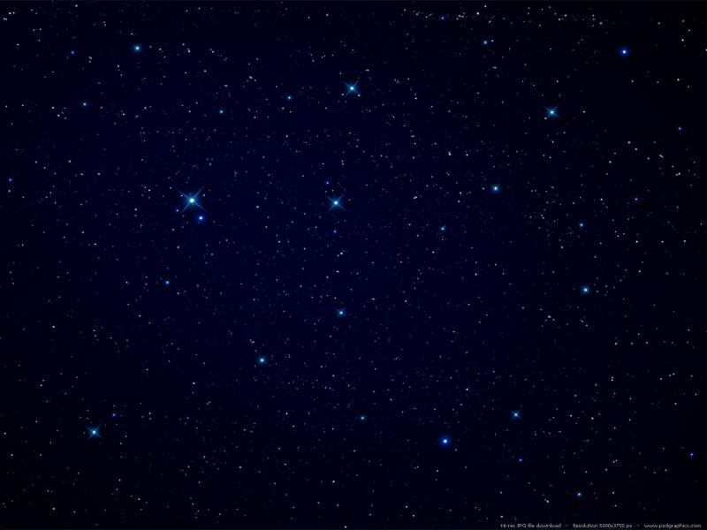

team MINDACTIVITY
2022 Demo Day

Slide 2
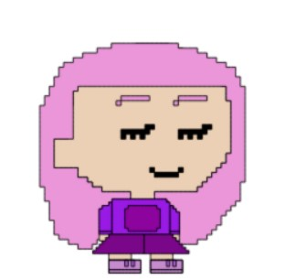
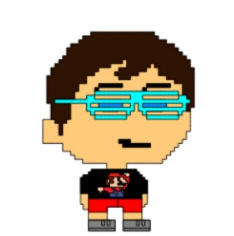
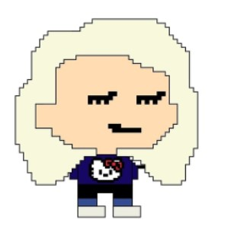
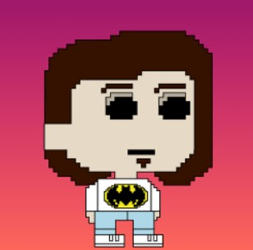
Meet the Team
Sadie
Ed
Philip
Anastasia

Slide 3
MINDFULLNESS + PRODUCTIVITY = MINDACTIVITY

Slide 4
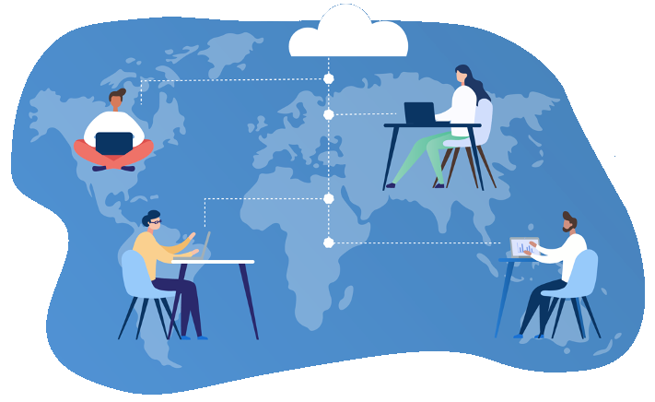

PROBLEM
How to enhance the remote experience of a bootcamper.
What can help them with the vast amount of learning?
What do they need?
What problem might they have that your application could solve for them?
How can you get into the mindset of your user and keep them at the centre of your problem-solving?

Slide 5


Bootcamp Burnout

Slide 6
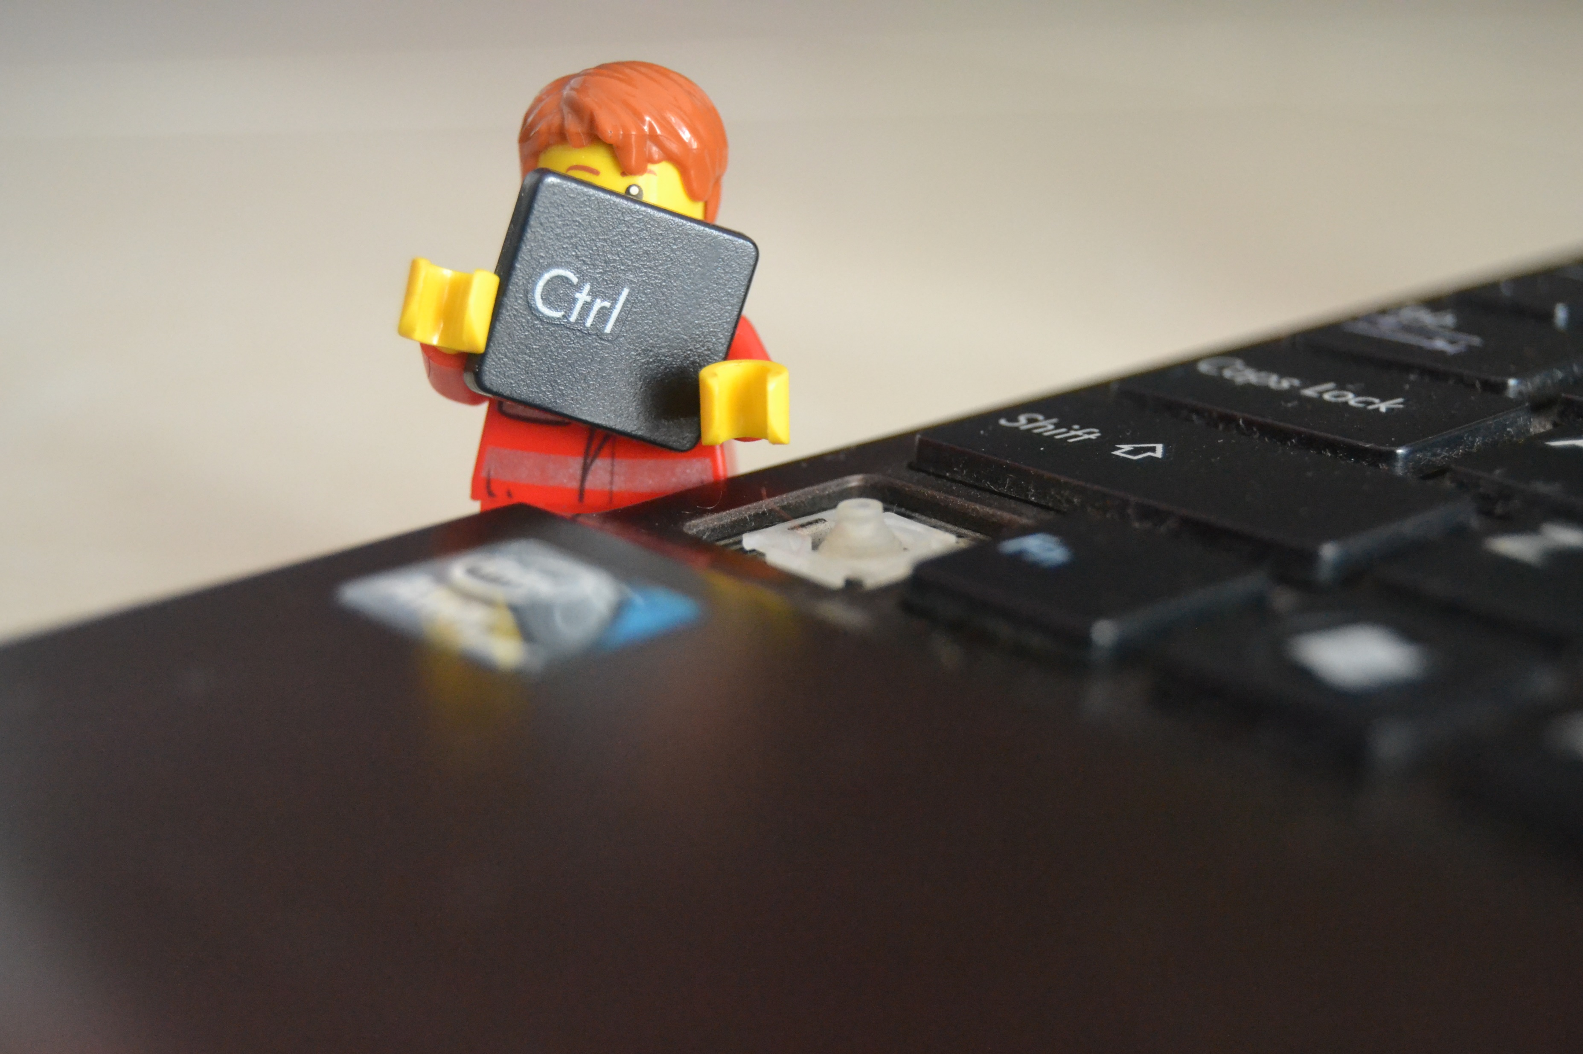
SOLUTION

Slide 7
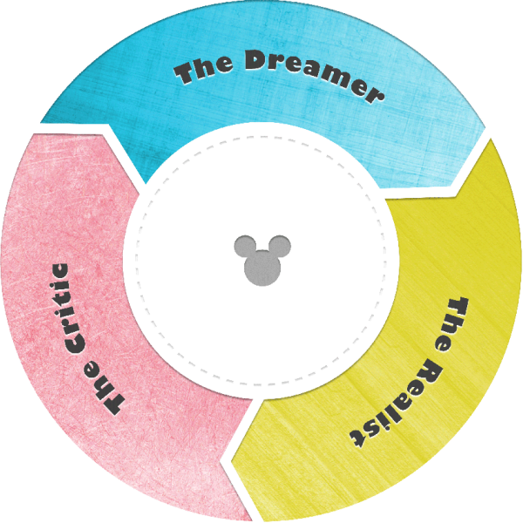
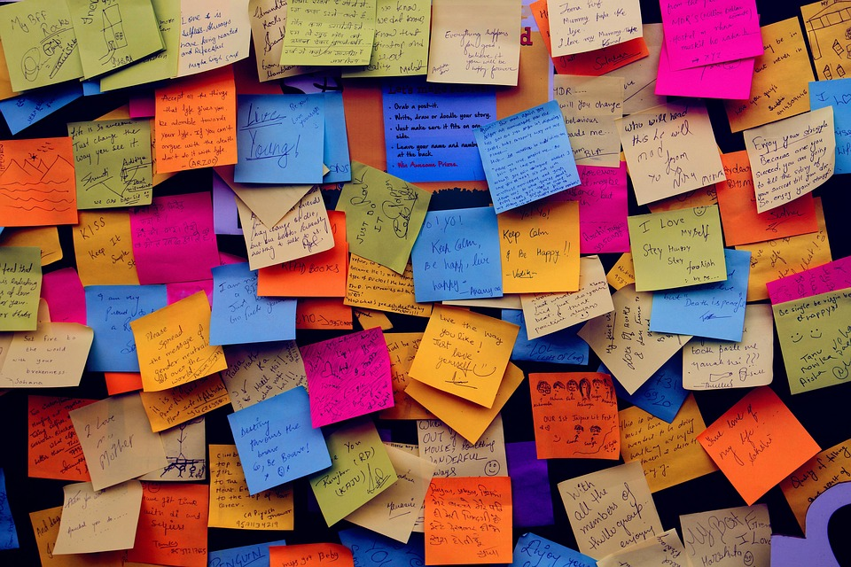
JOURNEY IDEATION & RESEARCH

Slide 8
Disney Ideation
Dreamer | Realist | Critic
Organisation Tools | Link to class notes, link to videos | No experience with audio API
Resources Access | Daily planner | Time constraints
Timer with gentle affirmations | ARIA html | When in doubt, stretch goal it
Personal assistant/tutor | Accessibility tools | More research needed
#Istruggletoo | API for affirmations | No experience with animations
Blog feature | Heroku database | External API vs Internal API
To-do List | High contrast website | Blog requires more than one user
Reminder | Nature sounds | Login authentication issues
Link App to Apple Watch | Mental health resources | Lack of originality

Slide 9
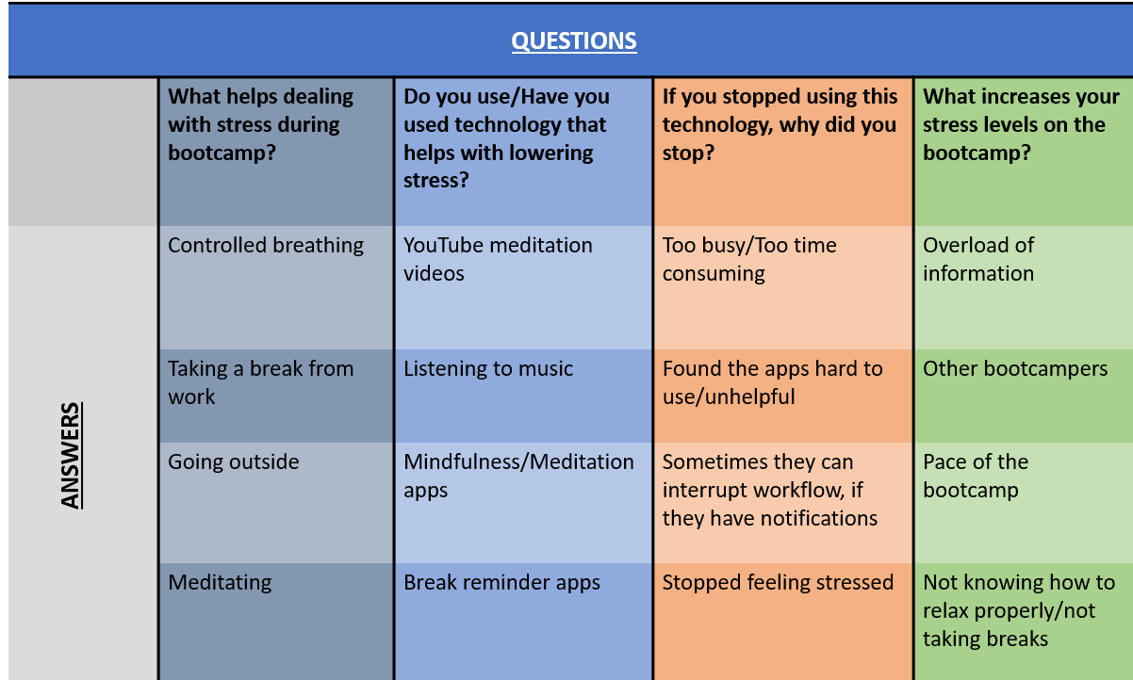
USER SURVEY

Slide 10
User Personas
Name: John Age: 55
Gender: male
Education: MBA
Previous Occupation: Director/Employee Assistant Div.
Extroversion Type: Extrovert
Level of physical activity: Sedentary
As an extroverted bootcamper, I want an app that includes an interactive blog feature so that I can connect with other bootcampers.
As a bootcamper with low level of physical activity, I want to use a stress relief app with a timer,
So that I can use it for exercise as well as meditation
Name: Esther
Age: 30
Gender: female
Education: Psychology A-Levels
Previous Occupation: self-employed
Extroversion Type: Introvert
Level of physical activity: Quite active
As an introverted bootcamper, I want an app which includes a meditation timer, so that I can spend some time in silence with my own mind
As a bootcamper with a high activity level, I want a stress relief app
So that I can have relaxing downtime

Slide 11
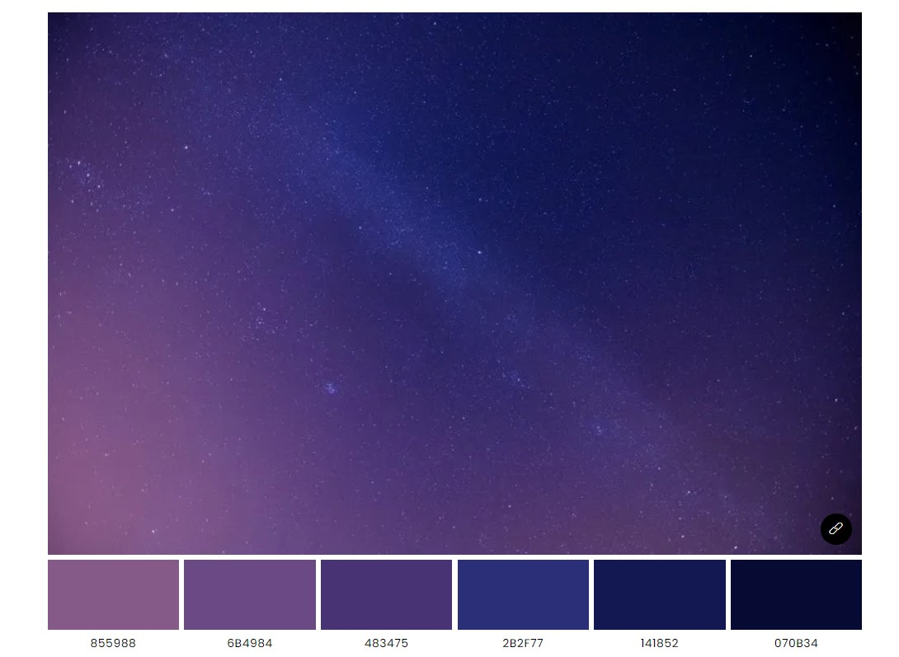
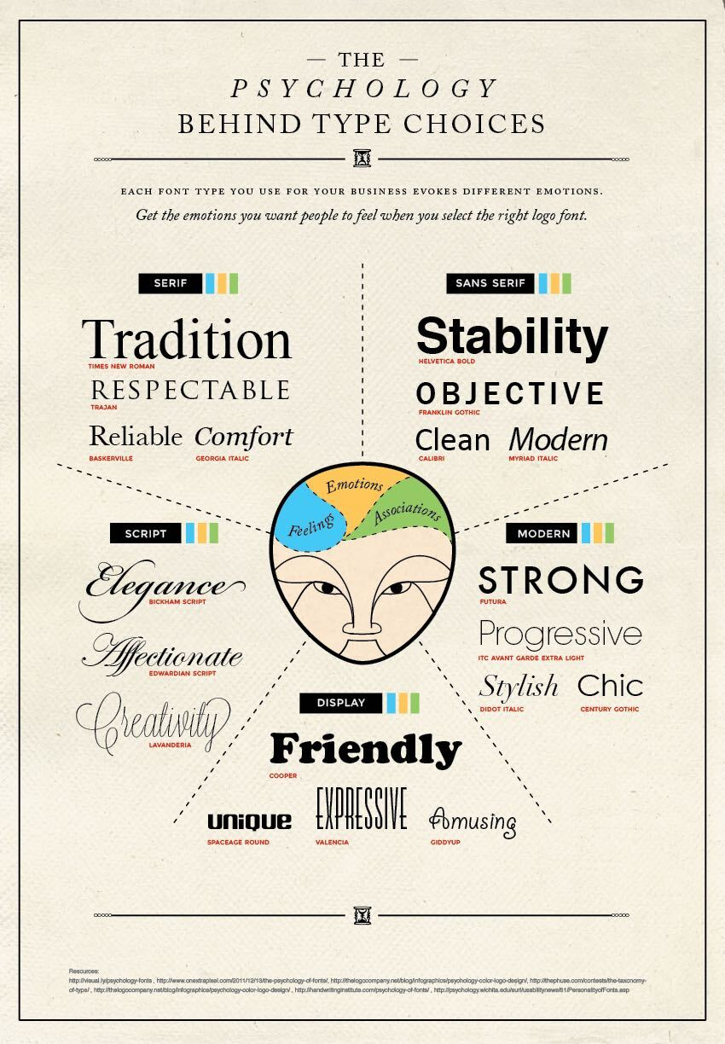
Colour Palette & Font

Slide 12
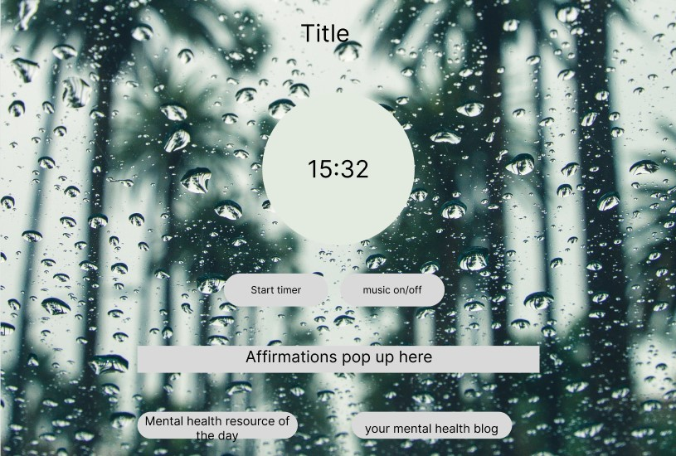
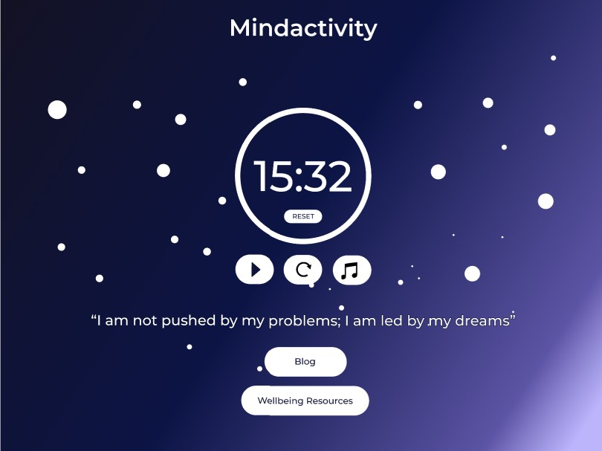
Wireframes

Slide 13
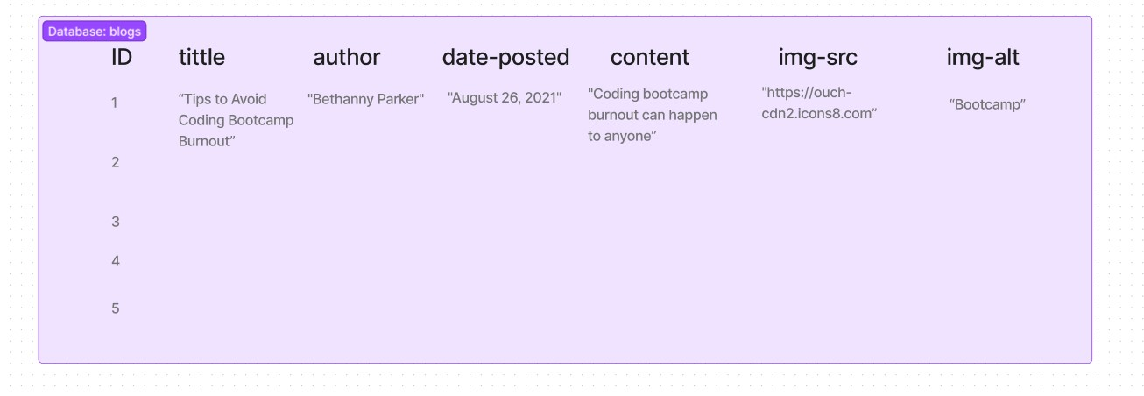
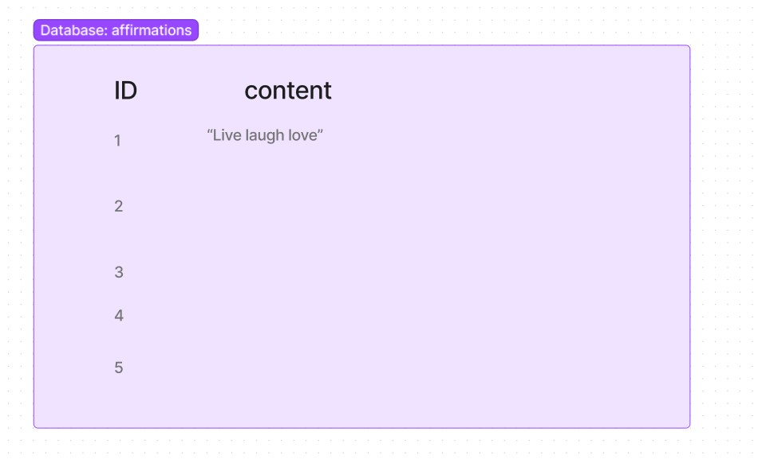
Database Structure

Slide 14
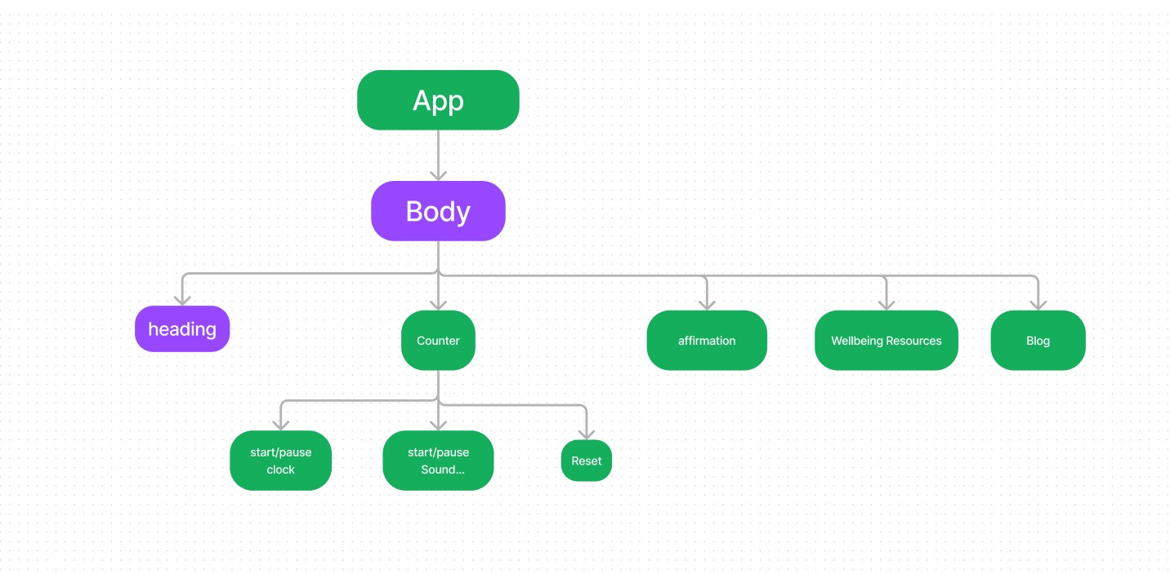
Component Tree

Slide 15
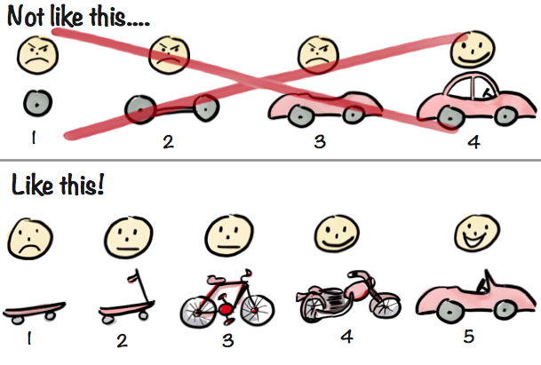
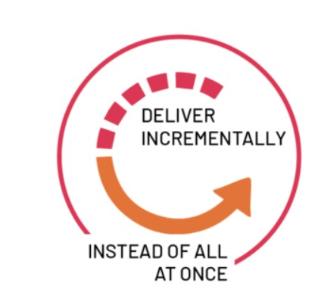
Agile Methodology

Slide 16
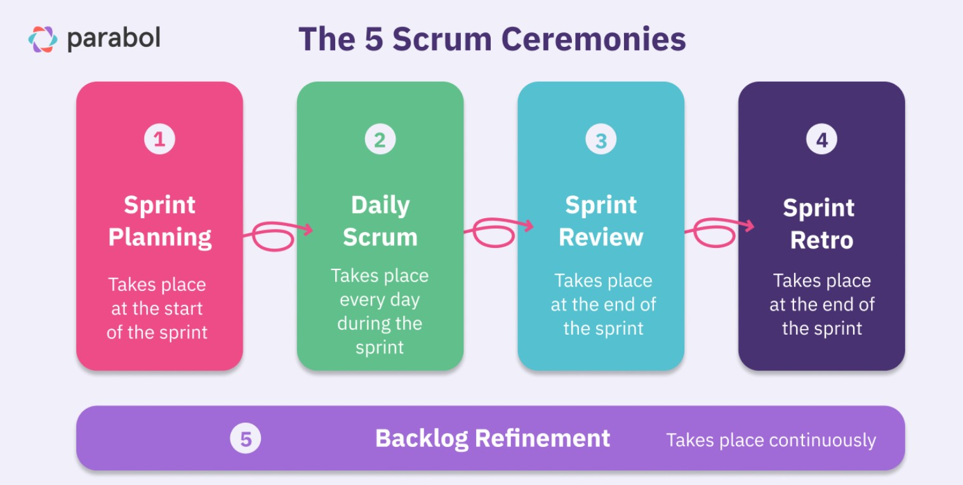
Daily Scrum Ceremonies

Slide 17
Agile
Sprint planning twice a day
Building a spring backlog
Surface blockers
Moving tickets from In Progress to Done
Daily scrum to check in
Daily Retrospective

Slide 18
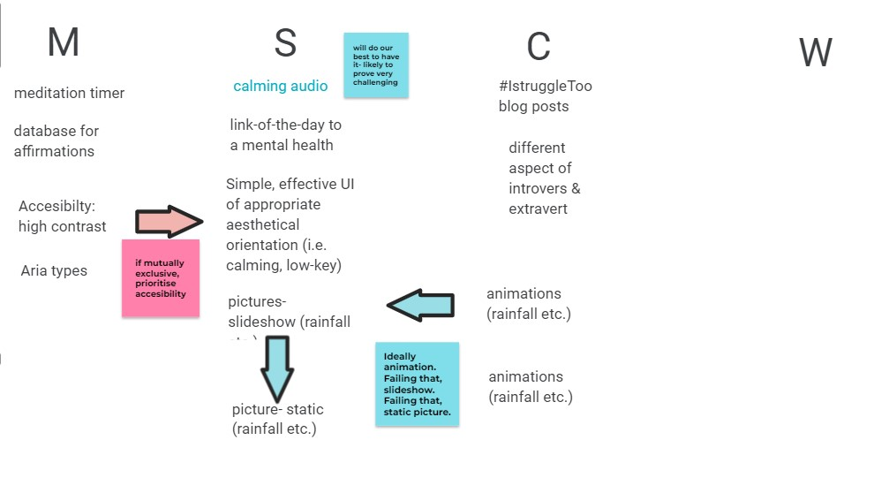
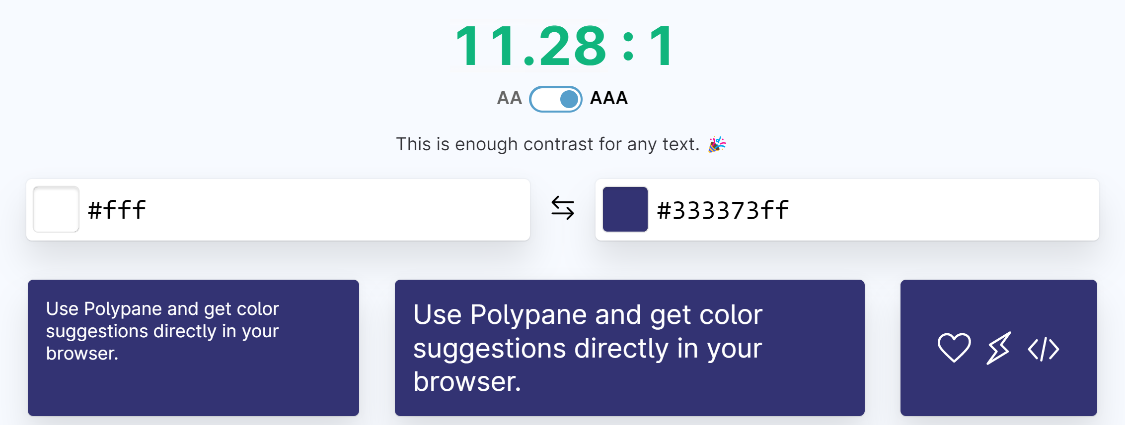
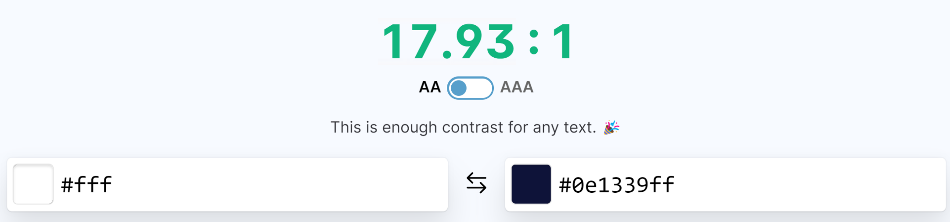
MoSCoW to MVP

Slide 19












Tech Stack
Front End
Back End
Testing

Slide 20
Challenges
Roadblocks
Vision Conflict
Sprint Fatigue

Slide 21
Future Implementations
ARIA types/keyboard accessible
Different background themes on toggle
Timer functionality so you can set your own time
TDD

Slide 22
Reflections
Sadie
Ed
Philip
Anastasia

Slide 23

Any Questions?

